Slide 1
Dynamic LACE for Preventing Hospital 30-day Readmissions
Justine Nguyen, Xiao Wang, Dan Yaeger
Notes:
Set the stage
Develop model to better patient care and improve cost effectiveness
Hello executives at general hospital! How are you?
There is a huge problem with re-admissions in our hospital system because people are not being effectively treated and they are coming back for more treatments. Our goal is to decrease readmissions by creating a model that will properly allocate our resources effectively.

Slide 2


https://www.disabledglobalchallenge.com/money-down-the-drain/
http://pie.med.utoronto.ca/PatientTeaching/
Notes:
Why do we need to change?
Cost of Readmissions within 30 days are continually increasing
Patients are not receiving the care they need and getting sicker
Hospital’s reputation suffers - patients lose confidence
CMS (Medicare services) penalizes readmissions
Average cost of $10K per patient

Slide 3
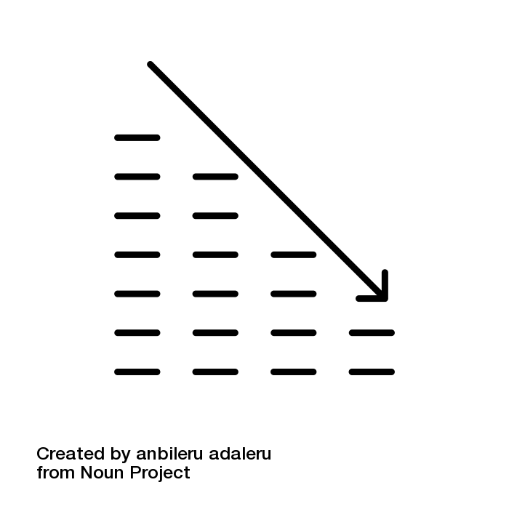
Notes:
Impact of not changing
Decline profits, customer satisfaction, efficiency
As we move from pay-for-service to pay-for-performance fee structure, the problem of financial penalties due to Readmissions will only increase. As hospital performance measures become more transparent, patients may choose to use hospitals other than ours. It is in our best interest to intervene and help high-risk patients and effectively mediate re-admissions. If we maximize customer satisfaction and our efficiency, this will benefit the hospital’s goal of service, high quality medical care, and cost efficiency.

Slide 4

Notes:
Solution: What if we could identify patients before they are readmitted?
We have implemented a well-known and tested tool to predict which patients will be re-admitted based upon data available in the EHR at the point-of-care
I can be implemented prior to discharge so we have this information
This tool will be available at the point of care and could be used as a decision aid within the EHR
By implementing this tool we would improve quality and improve services and lower costs

Slide 5

L - length of stay A - admission source C - comorbidity E - ER, number of visits
Notes:
JUSTINE START HERE
Explain LACE score.
LACE score - easily calcuable from EHR. Transparent, understandable

Slide 6
Likelihood
of Readmission
LACE score
Notes:
The outcome of LACE score is the probability of being readmitted within 30 days. So we put in the LACE score and get out the probability of a patient being admitted.

Slide 7
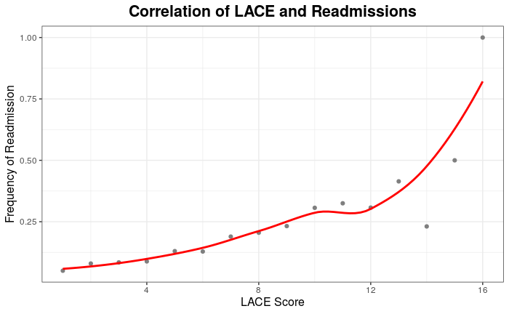
Notes:
Does this metric make sense? We can divide up the patients by their LACE scores and look at the probability of readmission per LACE score. We would predict that patients with higher LACE scores have higher risks of readmission and this is exactly what we see. This is good.

Slide 8

LACE Score: 10
LACE Score: 11
Notes:
Transition: So we know that LACE is valid in predicting high-risk patients, but we still have to determine a threshold of WHICH patients we are going to intervene with? Is the cut off at 7? 10? 12?

Slide 9

Maximizing benefit and minimizing cost
Cost Metric
Cost of intervention
Cost of readmission
Small when cost of readmission high
Large when cost of intervention high
Notes:
DAN START HERE
COST BENEFIT RATIO
-We still have to make a decision about deciding when to treat a patient based on their LACE scores.
- Ideally we would screen all patients, but given scarce resources we need to deliver an intervention that is feasible to prevent service failures
-We developed an additional algorithm on top of LACE that allows the LACE cutoff to be adjusted dynamically to maximize the number of patients correctly identified given certain costs
- We created a cost ratio that is based off of the Cost of Readmission/Cost of Intervention
- Right now we estimate the cost ratio to be around 10

Slide 10
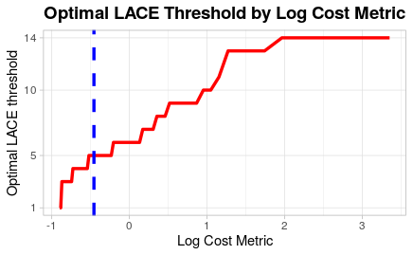


Increased
CMS
penalties
Increased intervention
cost
Notes:
We developed an additional algorithm that allows the LACE score cutoff to be adjusted dynamically according to the cost ratio.
Algorithm prioritizes the number of patients that need to be treated that receive intervention while minimizing cost
If CMS increases penalties, then we adjust the LACE threshold

Slide 11

Notes:
RELATE THE ORGANIZATION - HOW THE SOLUTION WILL BE USED & EXPLAIN THE IMPACT
- The solution will be used at the point of care specifically during discharge, it have to tide into the electronic record system.
- Perhaps scheduling another appointment with primary care within one week of discharge
- Improve Quality (Fewer readmissions)
- Improve Service (better patient care)
- Reduce/lower Cost
- Stop being penalized by CMS
Funding to study impact
Little time to value
Should be sustainable
BUILD ACTIVE ENGAGEMENT - WHAT WE WANT/ NEED THE AUDIENCE TO DO?
- MORE Investments !!!
- Money for roll out
- Build into EHR
- More resource/($) for implementation/study impact

